Slide 1



Post-16 Options
A guide for parents/carers
Supporting Your Child’s Future, Together

Slide 2
Contents
3 | Introduction
5 | Our Commitment
6 | Student Entitlement Statement
7 | What Happens After Year 11 at Anthony Gell School?
10 | Levels of Qualifications
12 | What are A Levels?
14 | The Extended Project Qualification
16 | What are BTEC Nationals?
18 | What are T Levels?
20 | Apprenticeships
22 | Levels of Apprenticeships
23 | Other Qualifications
25 | Options Summary
26 | Advice for Parents/Carers
28 | Making the right choice
30 | Thinking about University
31 | Behaviour and Attendance
32 | What if your GCSEs aren’t what you expected?
35 | Support for students with SEND
37 | Money Matters
40 | Further Information and Guidance
41 | Feedback and Involvement

Slide 3
Introduction
Thinking About What Comes After Year 11 at Anthony Gell School
What your child decides to do after Year 11 can make a big difference to their future. The choices they make now can affect how easy it is for them to get a job or continue studying later in life.
When they turn 16, there are two main options:
Stay in full-time education – like joining AGS Sixth Form, or Sixth Form in another school, or going to a College.
2. Start working and study part-time – like doing an apprenticeship or training while working.
There are a few important things for young people to think about when making their decision:
What kind of qualification they want to get.
How they learn best – in a classroom or through hands-on experience.
Which subjects or activities they enjoy most.
The large majority of students at Anthony Gell School choose to apply for a place in our Sixth Form. A smaller number of AGS students move on to college to study A levels or BTECs. Any of these options suit students who enjoy classroom learning.
If your child prefers learning by doing, they might enjoy T Levels or an apprenticeship more than they would studying for A levels. These options can lead to great results and open doors to good careers too.

Slide 4
It is important not to ignore an option just because it is new or not as well-known. In this guide, we will explain:
What choices are available after Year 11
Which types of students suit each choice
What qualifications they lead to
What opportunities come next
Where your child can study
What support (money and help with learning) is available
Finally, remember: whatever your child chooses after GCSEs, it’s not set in stone. It may shape what comes next, but it won’t block their future. If they change their mind later, there are always ways to change direction.

Slide 5

Our Commitment
At Anthony Gell School, we recognise the crucial role that parents and carers play in supporting their child’s career development and future planning. We are committed to ensuring parents and carers are informed, engaged, and empowered throughout their child’s careers education journey from Year 7 to Year 11 and beyond.
Our Careers Programme is fully aligned with the Gatsby Benchmarks, and parent/carer involvement is a key element across all areas.

Slide 6
Student Entitlement Statement
Careers Education, Information, Advice and Guidance (CEIAG)
As a student at Anthony Gell School you have the opportunity to receive the following: –
ACCESS to impartial advice and information about all career and progression options available to you
SUPPORT and GUIDANCE to help you make choices and complete a career plan for the future, at the appropriate time
HELP to decide what options to pursue at year 9, year 11 and year 13, including information about further learning, training or employment
A PLANNED PROGRAMME of careers education helping you to develop skills and knowledge to enable you to make choices and the transition into work or learning.
ACCESS to a range of online (and paper based) resources to help you to plan your next step, including labour market information, higher education and apprenticeship providers and career planning tools
You will also have the opportunity to: –
EXPLORE the world of work via access to a range of opportunity providers including – employers, voluntary organisations, further and higher education.
ATTEND events giving information on future learning opportunities within further and higher education
BE INVOLVED in making decisions about things that affect your learning and future career options.

Slide 7
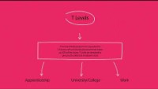




What Happens After Year 11 at Anthony Gell School?
All young people must continue in education or training until they are 18.
This doesn’t mean your child has to stay at school or go to college. They can get a job, but it must include some training – like an apprenticeship or a course. They can’t work full-time without doing some kind of learning.
What Are Their Options?
At 16, your child can:
Study academic qualifications like A levels, BTECs, T Levels, or the IB (International Baccalaureate).
Do vocational training like an apprenticeship, traineeship, or a job with training.
If they didn’t get the results they hoped for at GCSE, they can do a traineeship or internship to improve skills and experience.
Post-16 Options
Thinking About the Future
If your child already has an idea of what they want to do after age 18, it can help guide their choices now.
For example:
If they want to become a dentist, they’ll need to take science subjects.
If they’re good at and enjoy languages, they might choose to focus on those.

Slide 8
What Happens After Year 11 at Anthony Gell School?
.
What If They’re Not Sure Yet?
Many students don’t know what they want to do at 18 – and that’s completely normal.
In that case, it’s a good idea for your child to keep their options open. They can choose a mix of different subjects to help them find out what they enjoy most. This will give them more choices in the future.
Learning Styles Matter
Everyone learns differently, and this should help shape your child’s decision:
If they enjoy practical work or coursework, they might like BTECs, T-Levels, or apprenticeships.
If they prefer more traditional lessons, they might prefer A levels.
Why it is important to aim for Level 3 courses
At Anthony Gell School, we encourage all students to think about moving on to Level 3 courses after their GCSEs. These courses, like A-levels, BTECs, or T-levels, help a young person to learn more and prepare for the next steps in their future. Studying at Level 3 often gives a student better chances to get into university, start an apprenticeship, or find a good job. It also helps you build important skills like problem-solving and independent learning. Choosing to progress to Level 3 is a smart way to keep options open and work towards goals.
Remember
There are many different ways to reach the same career goals. It’s better for your child to choose a path that matches how they learn and what they enjoy, rather than pick something just because they think they have to. Choosing the right option for them will give them a better chance of success and happiness.

Slide 9

Post-16 Qualifications

Slide 10

Levels of Qualifications
Understanding Qualification Levels
In England, Wales and Northern Ireland, qualifications are grouped into levels from Entry Level up to Level 8.
Entry Level is for people who are just starting out.
Levels 1 to 3 are the ones most students work towards at school or college.
The higher the level, the more advanced and challenging the qualification is.
Qualifications Explained
What Do These Levels Mean?
There are lots of different types of qualifications, so it can be confusing to know what they all lead to.
To help make it easier, we’ve put together a simple guide to show:
What each level means
The different types of learning – academic, vocational, and work-based
How each route can lead to higher education or a future career
Remember, GCSEs are a Level 2 qualification. To progress further and gain more skills students should aim for Level 3 qualifications where possible.

Slide 11
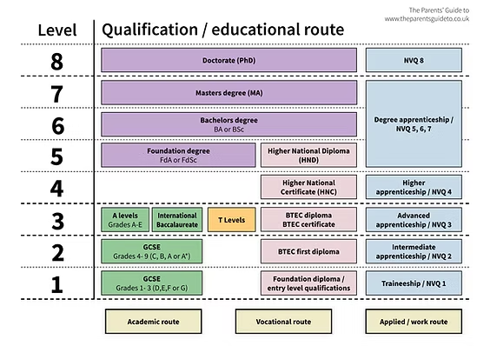

Slide 12
What are A-Levels?
A Levels (Advanced Level qualifications) are courses where students study a subject in more detail over two years. At the end of the two years, there are exams to test what they’ve learned.
Most learning is done in the classroom, with support from teachers.
How Many A Levels Do Students Take?
Most students take three A levels.
Some may take four, but only the top three grades count when applying to university.
These grades are turned into ‘UCAS points’, which are used by universities to offer places on courses.
UCAS points for A levels range from 16 to 56 points, depending on the grades a student gets.
Choosing Subjects
There are more subjects available at A level than at GCSE – so your child might pick something they haven’t studied before.
If they find they don’t enjoy it, or it’s not what they expected, most schools and colleges will let them change subjects in the first half term.
Usually, your child will need at least a Grade 6 at GCSE in a subject they want to continue at A level – though sometimes exceptions can and are made.

Slide 13



What are A-Levels?
Qualification type
General Certificate of Advanced Level qualification
Type of learning
Mostly theory
Qualifications needed to sign up
At least 5 GCSEs grades 4 - 9 and at least a
grade 5/6 in the subject/s chosen for A level
(requirements may vary between schools)
Subject choices
Usually three subjects
Length of commitment
2 years full-time
Tuition costs
Free (unless parents/carers choose to pay privately)
UCAS points awarded for passing
56 points – A*
48 points – A
40 points – B
32 points – C
24 points – D
16 points – E
Can lead to
University, further study, training or work
What is an A-Level?
Useful Links
If your child wants to benefit from different learning styles, some schools offer the option to take a combination of A levels and BTECs.

Slide 14

The Extended Project Qualification
What Is the EPQ?
At some Sixth Forms, including at AGS, students can take an extra qualification called the EPQ – the Extended Project Qualification.
This is a research project that a student chooses and works on mostly by themselves. It can be:
A long essay (dissertation)
A creative project
A product with a written report
An EPQ is worth between 8 and 28 UCAS points, depending on the grade the student achieves.
What Makes the EPQ Different?
The EPQ is very independent – the student will:
Pick their own topic (something they’re interested in)
Plan and organise their time
Do their own research
Meet deadlines on their own
Create the final project
What Is the EPQ?
They’ll get some support from a teacher, but less than other qualifications.
This style of learning is more like university or the workplace, where students are expected to manage things themselves. It’s great preparation – but it’s not for everyone.
Make sure your child is happy working on their own before choosing this option.

Slide 15


The Extended Project Qualification
How Does It Help With University?
The EPQ is worth half an A level. Unlike a fourth A level, the UCAS points from the EPQ are added on top of the points from their three main A levels.
This means an EPQ could help boost your child’s UCAS points and improve their chances of getting into university. Some universities may even lower their typical offer to a student who achieves a certain grade in their EPQ.
Some universities even give two offers:
One without the EPQ (e.g. BBB)
One with the EPQ (e.g. BBC plus a pass in the EPQ)
This can give your child more flexibility when applying.
What Skills Will They Learn?
By doing an EPQ, your child can develop really useful skills, such as:
Time management
Doing research
Summarising large amounts of information
Staying motivated
Giving presentations
Reflecting on their work
Working independently
Handling feedback
Learning from mistakes
These skills are great to talk about in university personal statements or job interviews.
Students can choose the subject matter for their EPQ, so this can be focused around their interests or future degree /
career plans.

Slide 16

What are BTEC Nationals?
What Are BTECs?
BTECs at Level 3 are qualifications that are similar to A levels, but focus more on practical, work-related subjects. They are a great option for students who learn best by doing rather than just sitting in a classroom.
Types of BTEC Qualifications
There are three types of BTECs your child can take at Sixth Form or College:
Subsidiary Diploma – equal to 1 x A level
Diploma – equal to 2 x A Levels
Extended Diploma – equal to 3 x A Levels
They are studied over two years, just like A Levels.
How Are BTECs Taught and Graded?
Students learn through a mix of practical tasks and theory (classroom work)
They are assessed mostly by coursework, with a final exam that makes up 40% of the final grade
UCAS Points and University
BTECs can earn your child UCAS points – just like A Levels.
A subsidiary diploma can earn 15 to 56 points, depending on the grade.
A diploma is worth double, and an extended diploma is worth three times as much.
This means your child can still go to university with BTECs – but they should check if their chosen course or university accepts them, as some prefer A Levels.
Mixing BTECs and A Levels
Many schools (including AGS) allow students to combine A Levels and BTECs. This gives them a mix of classroom and practical learning.
Important to Know:
From 2024, the Government reduced funding for qualifications that are not:
A levels
T-Levels
Apprenticeships
This means that BTECs may be phased out over time. If your child is interested in BTECs, it is important to speak to their school or college about what’s still available and how this might affect future choices.

Slide 17


What are BTEC Nationals?
Qualification type
Business and Technology Education Council Diplomas
(Level 3 are similar standard to
A Levels, with subsidiary diploma equivalent to one A Level, BTEC diploma equivalent to 2 A Levels and extended diploma equivalent to 3 x A Levels).
Type of learning
Combination of practical and theory
Qualifications needed to sign up
Up to 5 GCSEs
Subject choices
Up to three vocational subjects
Length of commitment
2 years full-time
Tuition costs
Free (unless parents/carers choose to pay privately)
UCAS points awarded for passing
56 points – D* (distinction)
48 points – D
32 points – M (merit)
16 points – P (pass)
Can lead to
University, further study, training, professional development programmes or work
I Choose BTECs.
BTECs offer the chance of earning the same points for UCAS as A levels and provide a way to learn through practical application and coursework.

Slide 18
What are T-Levels?
What Are T-Levels?
T-Levels (Technical Level Qualifications) were introduced in September 2020 by the Government.
They are designed with the help of real employers to give students the skills and experience they need to go straight into work, further training, or university.
What Can You Do After a T- Level?
After finishing a T-Level, your child can:
Go straight into a skilled job
Apply for a higher apprenticeship
Go to university (if they meet the entry requirements)
Key Facts About T-Levels
A T-Level takes 2 years to complete
It is equal to 3 A levels
You’ll learn in the classroom and also spend time in a real workplace
You can earn between 72 and 168 UCAS points, depending on your grades
T-Level Transition Programme
If your child isn’t quite ready to start a T-Level straight after GCSEs, they can take the T-Level Transition Programme: a one-year course that helps them prepare.
This programme includes:
Introductory lessons in their chosen subject
Work experience
Extra support with English and Maths (if they didn’t get a grade 4 or higher in GCSE)
It’s a great way to build confidence and skills before starting the full T- Level.
T-Levels are a good option for students who enjoy hands-on learning and are ready to gain real experience in the working world.
What Makes T-Levels Different?
T-Levels combine classroom learning with an industry placement – this is a real job in a real company.
The placement lasts for 315 hours (about 45 days)
That’s around 20% of the whole course
Some students are even offered a job afterwards!
The work experience is also great to show universities or future employers.

Slide 19
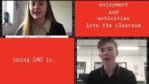

What are T-Levels?
Qualification type
Technical Level Qualification
Type of learning
Classroom learning (80%) with industry placement (20%)
Qualifications needed to sign-up
Set by the college (usually up to 5 GCSEs)
Subject choices
As of September 2024, there are now over twenty subjects available including accounting, engineering, digital business services, education and childcare, finance, health, law, management, on-site construction and science.
Length of commitment
2 years full-time
Tuition costs
Free (unless parents /carers choose to pay privately)
UCAS points awarded for passing
168 points – Distinction*
144 points – Distinction
120 points – Merit
96 points – Pass (C or above)
72 points – Pass (D or E)
Can lead to
University, further study, training, professional
development programmes or work
What are T-Levels?
First-hand work experience is hugely
beneficial to students, enabling them to get a feel for what it’s like
in the world of work and whether they like the industry sector they’ve chosen – it’s not too late to make a
change post-18 if they don’t!

Slide 20
Apprenticeships
What Are Apprenticeships?
Apprenticeships are real jobs that also include learning and training. Your child works for an employer while also studying at college, university, or with a training provider.
They are a great choice for students who want to earn money, gain work experience, and learn practical skills at the same time.
Apprenticeships were designed to help fill skills gaps in UK businesses and are a good way to build professional skills that are useful in many jobs.
What Qualifications Will They Get?
Apprenticeships lead to recognised qualifications. For example:
A Level 3 Apprenticeship gives your child a qualification equal to 2 A levels
They might earn National Certificates, National Diplomas, or NVQs
These qualifications can help them move on to higher education, further training, or a job when they turn 18.
How Apprenticeships Work
The young person works for an employer, doing a real job
They also study part-time to gain qualifications
They get paid while they learn
The training can happen at a college, university, or training centre.
Can They Continue After the Apprenticeship?
Yes! Many apprenticeships allow students to progress to a higher level. After finishing a Level 3 Apprenticeship, the young person might be able to start a Level 4 or 5 Apprenticeship These are called Higher Apprenticeships, and some even lead to a degree.
Not all employers offer this, so it’s important to check with the company before applying. Apprenticeships are a strong choice for those who enjoy hands-on learning and want to work as they learn.
Starting an Apprenticeship at 16
At 16, students can apply for:
Level 2 Apprenticeships – for students with few or no qualifications
Level 3 Apprenticeships – usually need 5 GCSEs, including English and Maths
There is no Level 1 Apprenticeship, but students without qualifications can do a traineeship or internship first to help them build the skills they need

Slide 21


Apprenticeships
Qualification type
Advanced Level 3
(equivalent to 2 A-Levels)
Type of learning
Work based including off-site learning
Qualifications needed to sign up
Advanced Level 3 - depends on employer, some
require at least 3 GCSEs. Students need to show
they can complete the programme
Subject choices
Range of vocational subjects, driven by the job offered.
Length of commitment
1-2 years
Tuition costs
Free (unless parents / carers choose to pay privately)
Can lead to
Further study, training, professional development programmes or work
Apprenticeships Explained
Unlike BTECs, which are
studied at school or college,
apprenticeships also include
an element of study at work,
so there is a real-life
component to the course.

Slide 22


Levels of Apprenticeships
Level 2
Intermediate
Typical length
12-18 months
Entry requirements:
None or few
Qualifications obtained:
GCSE, BTEC or equivalent
Who’s it for?
Mostly for 16-year-olds with limited or no academic qualifications.
Level 3
Advanced
Typical length
12-24 months
Entry requirements:
Usually 5 GCSEs
Qualifications obtained:
A levels or equivalent
Who’s it for?
Mostly for 16-year-olds with reasonable academic achievements but who don’t
want to study in sixth form.
Typical length
3-5 years
Entry requirements:
A levels or equivalent
Qualifications obtained:
Higher national diploma / foundation degree
Who’s it for?
Mostly for those who want to qualify for professional career paths without attending university or college.
Level 6/7
Degree
Typical length
3-7 years
Entry requirements:
At least 2 A levels or equivalent
Qualifications obtained:
A BA or BSc degree or higher
Who’s it for?
Mostly for those with excellent sixth form results that want to study for a degree or similar whilst working.
Level 4/5
Higher

Slide 23

Other Qualifications
Other Qualifications
Other qualifications you can take include Cambridge Technicals, City and Guilds, National Vocational Qualifications (NVQs), and the Tech Bacc (which is similar to the International Baccalaureate). These are all vocational courses, which means they focus on skills and knowledge for specific jobs. They are a good option for students who already know what kind of job they want after school, or for those who prefer learning in a more practical, hands-on way, while still doing some classroom work.
Cambridge Technicals
Cambridge Technicals are split 50% coursework and 50% exams. They offer a very practical way to learn. To do well, students need to be well-organised, able to work on several projects at the same time, and meet deadlines.
National Vocational Qualifications (NVQs)
NVQs are a work-based way of learning. There are no exams. Instead, students are assessed on how well they can do specific tasks. Although NVQs are job-focused, they can be studied at school, college, or in the workplace.
In most cases no UCAS points are
awarded but these qualifications
provide an excellent route into industry.

Slide 24


Other Qualifications
Qualification type
City and Guilds; National Vocational Qualifications (NVQs) or Tech Bac (similar to International Baccalaureate)
Type of learning
Dependent on the qualification, most contain practical on the job training
Qualifications needed to sign up
Usually 5 GCSEs grade 4 - 9, but check individually
Subject choices
Range of vocational subjects
Length of commitment
2 years (Level 3)
Tuition costs
Free (unless parents/carers choose to pay privately)
UCAS points awarded for passing
In most cases no UCAS points are awarded but there are some exceptions.
Can lead to
Further study, training, professional development programmes or work

Slide 25
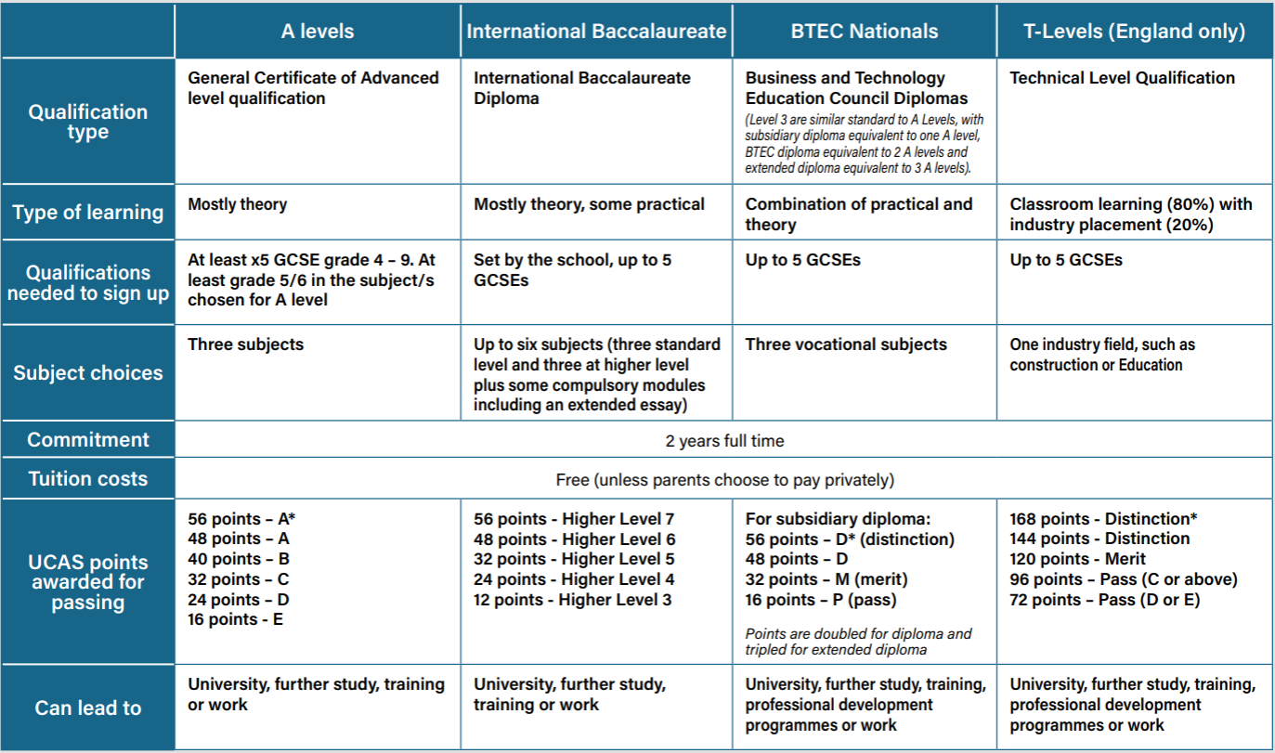
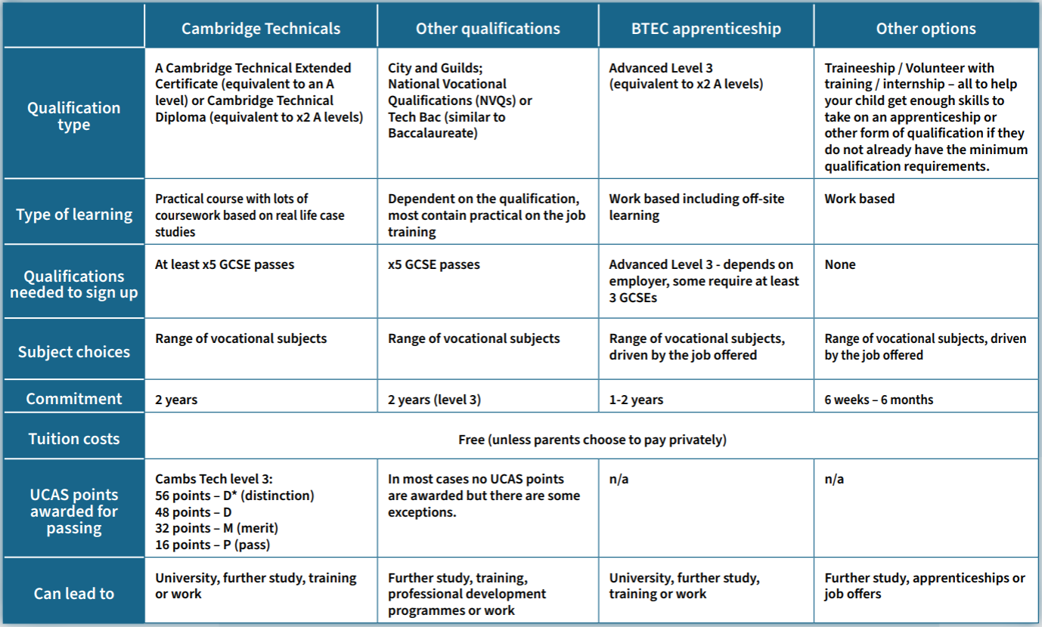
Options Summary

Slide 26
Advice for Parents/Carers: Part One
There are lots of choices available to your child once
they've completed GCSEs or other Level 2 courses, so it’s good to know what's on offer.
A-Level and IB are more suited to theoretical learning;
BTECs and T Levels are great for those who enjoy practical experience and coursework;
EPQ offers the chance to earn more UCAS points as well as undertaking a project centred around your child’s personal interests;
Apprenticeships, traineeships and internships provide on the job training and valuable experience. ensure your child prepares in advance.
There are lots of options open to your child, so make sure they understand them all before making a final decision. It's OK if your child doesn't know what they might want to do after school – try to help them make choices that will keep their options open
Attend open days to get first-hand experience of the atmosphere at different learning providers if your child is thinking of making a switch from school. Finding the right learning environment is very important for their future success.
Make sure your child's contact details are up-to-date on CVs and applications, especially if using personal email addresses, otherwise they could miss out on potential offers.

Slide 27

Informed Choices

Slide 28
Making the Right Choice
For some students at Anthony Gell School, deciding what to study after GCSEs is simple. For others, it can be more difficult to choose the right subjects. If your child needs help making this decision, here are some important things to think about:
What your child is good at and enjoys
We usually do better at things we enjoy. If your child likes certain subjects and does well in them, these could be strong choices for Sixth Form. It’s also important because they will be spending a lot of time studying each subject, so it helps if they’re interested in it.
GCSE results can give a good idea of how well your child might do at A-level or in other post-16 courses. If they haven’t studied a subject before, it’s a good idea to speak to teachers of that subject for advice.
For example, if your child wants to study a new language that wasn’t offered at GCSE, look at how well they did in the language subjects they did take.
Also, think about whether your child prefers practical work (like projects or hands-on tasks) or theory-based learning (like essays and written exams). This can help guide the decision.

Slide 29
Making the right choice
What your child wants to do in the future
If your child already knows what job or career they want, or what they want to study at university, their subject choices may be more obvious.
For example:
To become a pharmacist, your child will need Chemistry, and at least one of Biology, Physics, or Maths.
Sometimes a student really wants a certain career, but struggles with the subjects they need to get there. In this case, vocational courses or apprenticeships can be a better fit.
For example:
A student who wants to go into business but finds A-Level Economics too focused on maths might prefer a BTEC in Business Studies.
Another option could be an apprenticeship in an area like hospitality or leisure, where they can learn on the job while working.
At Anthony Gell School, we encourage all students and families to talk to teachers and career advisers. Making the right choice after GCSEs is important and we’re here to help guide you through it.

Slide 30
Thinking About University
If your child is thinking about going to University after Sixth Form, it’s important to know that each University is different. They have different entry requirements, which means they expect students to take certain subjects and get certain grades.
If your child has a University or course in mind, you should check the University’s website to find out exactly what they need. Sometimes, even courses at the same University ask for different subjects or grades. If you’re unsure, it’s okay to phone the University and speak to their admissions team.
Not All Qualifications Are Equal
Some top Universities don’t treat all Sixth Form qualifications the same. For example:
Some Universities don’t accept T- Levels or BTECs for certain courses.
Some A-Levels are seen as more important than others.
To keep as many University options open as possible, it’s a good idea for your child to choose a mix of well-respected subjects. These are often called “facilitating subjects”, and include:
Biology
Chemistry
English
Geography
History
Maths
Modern or Classical Languages
Physics.
These subjects are recommended by the Russell Group – a group of 17 leading UK Universities known for academic research and high entry standards.
Where to find out more
Speak to your child’s current teachers;
Speak to Sixth Form teachers;
Speak to other students;
Read subject guides;
Review university websites or speak to the university’s admissions;
Check text books and reference books

Slide 31
Behaviour Attendance and Punctuality
It’s not uncommon for teens to think that poor behaviour and attendance won’t have a lasting impact.
Help them be aware!
Not only is it more likely that students that behave poorly won’t do as well in their GCSEs, but behaviour counts too. Low attendance also has a direct impact on a teens ability to succeed in their GCSEs. If they are not in school, they are not learning the information they need in their exams.
Some schools, (the school they’re already at or a different one), won’t accept students into Sixth Form if they have regular records of poor behaviour and poor attendance / punctuality.

Slide 32
What If GCSE Results Aren’t What Your Child had Hoped for?
When GCSE results come out in August, some students at Anthony Gell School might find they didn’t get the grades they hoped for, especially in the subjects they planned to study at Sixth Form or in College.
If this happens, it’s really important for parents and carers to stay calm, supportive and reassuring. Try not to show anger or frustration, even if you feel like saying, “I told you so!”
A positive attitude helps your child move forward and find new opportunities faster.
Can They Still Study Their Chosen Subjects?
Low grades don’t always mean your child has to give up on the subject they wanted to study. In some cases:
They might be allowed to start the course anyway
They could be given the chance to resit the GCSE while beginning the Sixth Form subject
Or, they may need to consider a different subject that better matches their skills
Sometimes, GCSE results give a clear sign about whether a subject will be too difficult going forward. If your child has struggled in that subject, it might be best to look at alternative options. Speak to their teachers at AGS and ask for advice on the best path forward.

Slide 33
What If GCSE Results Aren’t What Your Child had Hoped for?
What Are Their Options If They Didn’t Do Well?
Here are some possible next steps:
Talk to the Sixth Form or College they applied to.
  They might still accept your child, even without the required grades.
  At AGS there are a range of alternative pathways that we can consider with you and your child if they didn’t get the grades that they need.
  Some courses will allow them to start the course if they agree to do extra work or show they’re committed.
Retake GCSE subjects they didn’t get a grade 4+ in
  This can happen alongside starting a new course.
Study somewhere else
  Another school or college might offer a similar course without requiring a resit.
Do a traineeship, internship or volunteer placement
  These give your child real-world experience and help them show they’ve got the skills to continue studying or working in a specific field.
Start an apprenticeship
  This lets them earn while they learn, gaining work experience and qualifications at the same time
At Anthony Gell School, we understand that not every journey is the same. If results day in August doesn’t go to plan, we’re here to help your child explore all their options and support them in making the right decision for their future.

Slide 34
Additional
Support

Slide 35
Support for Students with SEND After Year 11
If your child has SEND (Special Educational Needs or Disabilities) and they’re moving to a new school, college, or education provider after Anthony Gell School, it’s important to let the new place know as early as possible. This gives them time to plan the right support or get extra help if needed.
Ongoing Support and Monitoring
The new school or college should:
Regularly check how your child is doing
Keep written records of reviews and support plans
Talk directly with your child about their needs
As a parent or carer, you should agree with your child and their new setting about how you’ll stay updated, so you can continue to give the right support at home too.
Finding Local Help
Every Local Authority (like Derbyshire County Council) must offer free information and advice to support young people with SEND. This is called the Local Offer.
You can find this information:
On your local council’s website
By calling their SEND support team
Or by speaking to someone face-to-face
The Local Offer tells you about services available for education, health, and care in your area.
You can also ask for help from:
Your child’s current school
Your GP
Charities and support organisations that work with young people who have additional needs

Slide 36

Support for Students with SEND After Year 11
Education, Health and Care Plans (EHC Plans)
If your child has an EHC Plan, it will still apply when they move on to Sixth Form or College (but it won’t usually carry on into University or higher education after age 18).
If your child needs extra help beyond what the school or college can provide, you may be able to ask for a Personal Budget. This can help with costs like therapy, equipment, or transport. You’ll need to apply through the local authority, and each request is considered individually.
At Anthony Gell School, we work closely with families to make sure students with SEND are supported during this important transition. Whether your child is staying on in education or moving somewhere new, it’s vital that the right support is in place and we’re here to help you navigate that process.
All Further Education providers should have a named individual in charge of SEND provision.
Benefits
If your child has SEND they might
get some help during exams, such
as more time, permission to use
technology (such as being able to
type a paper rather than handwrite
it), a reader, a scribe, rest breaks and even a separate room. However, they will have to demonstrate a history of need.

Slide 37
Money Matters
After Year 11, your child can continue their education or training for free, as long as they’re not going to a private school. This applies to Sixth Forms, Colleges, and most training providers.
Child Benefit and Other Support
If you currently claim:
Child Benefit
Child Tax Credit
Universal Credit for your child
These payments usually stop when your child turns 16 — unless they stay in full-time education or training.
To keep receiving these, you must tell the relevant department (e.g. HMRC or DWP) that your child is still studying. These payments can then continue until your child turns 19.
What Other Help Is Available?
Free School Meals
If your family is on a low income, your child might be able to get free meals while studying.
To qualify:
They must be studying at a school, college, or training centre funded by the government, like those supported by the Education and Skills Funding Agency (ESFA).
You can ask staff in Anthony Gell School or the sixth form/college your child is going to for help applying.
Help With Living Costs (Residential Bursaries)
If your child has to move away from home to attend a specialist course, they might be able to get money to help with accommodation. This is called a Residential Bursary.
It’s designed to support students who need to live elsewhere to study the right course for their career.

Slide 38
Money Matters
Extra Help for Vulnerable Students
Some students can get up to £1,200 per year through a special bursary
If they are in a vulnerable group, such as:
Being in care or leaving care
Getting Income Support or Universal Credit themselves
Receiving Disability Living Allowance (DLA) or Personal Independence Payment (PIP)
This bursary can help pay for travel, food, books, or equipment.
At Anthony Gell School, we encourage all students and parents/carers to ask about financial support early. Whether it’s help with meals, travel, or bursaries, there’s often more support available than people realise, and we’re here to help you find it.
Extra Financial Help for Students (2026 Onwards)
There is extra support available for students who may need financial help while continuing their education after Year 11; even if they don’t qualify for the main bursaries.
Discretionary Bursary
If your child doesn’t qualify for the vulnerable student bursary, they may still be able to get a discretionary bursary.
This is decided by the school, college or training provider and can be used for things like:
Travel to and from school or college
Course equipment or uniform
Meals
Books or materials
The amount given depends on your child’s situation and what they need to help them stay in education.
You can ask the Sixth Form or College your child plans to attend.

Slide 39

Money Matters
Grants from Charities
Some charities also offer small grants to help with the extra costs of studying. One example is the Family Action Trust.
These grants can help cover:
Course-related clothing or uniforms
Equipment (e.g. art supplies, tools, protective gear)
Travel costs
Exam fees
Laptops or computers for learning
These grants are often based on family income, so it’s worth looking into if your child needs help.
Care to Learn – For Young Parents
If your child is under 20 years old and has a child of their own, they may be able to get help with childcare costs while they study.
This is called the “Care to Learn” scheme. It provides up to:
£160 per week for childcare (outside London)
£175 per week (in London)
This support is given through the Student Bursary Support Service, and it helps young parents continue their education without worrying about childcare costs
16 to 19 Bursary Fund
At Anthony Gell School, we encourage students and families to ask about all available financial support early — especially if cost could become a barrier to learning. There’s often help out there, and we’re here to point you in the right direction

Slide 40





Further Information and Guidance
Please see below for resources and links that can offer you further information on careers guidance and future pathways:
TalkingFutures.org.uk
Talking Futures will help you have informed and constructive career conversations with your child about their academic and professional future.
Successatschool.org
Career advice for schools and students aged 13-19. Search jobs, advice & find out about employers, work experience, courses, career choices and apprenticeships
Apprenticeshipguide.co.uk
With over 600 apprenticeships on offer, use this site as a tool to discover your perfect role by searching through the 18 different industry sectors
Nationalcareers.service.gov.uk
We provide careers information, advice and guidance. We can help you make decisions at all stages in your career.
Lmiforall.org.uk
The LMI for All portal provides high quality, reliable labour market information (LMI) to inform careers decisions.

Slide 41
Feedback and Involvement
We actively seek feedback from parents and carers to help shape our CEIAG provision. We welcome:
Parent / carer participation in employer panels and events
Offers of work experience placements.
Feedback through surveys and informal discussion.
Suggestions for improving communication and support.
Contact Us
If you would like more information, or want to get involved in our Careers Programme at AGS, please contact:
Katy Lowe – klowe@anthonygell.co.uk
Jay Grindey – jgrindey@anthonygell.co.uk

