Slide 1

AGS Year 12 Curriculum Information Evening

Slide 2

AGS Year 12 Key Calendar Dates
Oxford University Roadshow: 30th Sept 2025
Sixth Form Parents’ Evenings: 6th November 2025 and 26th March 2026
Mock Exams: 22nd June to 3rd July 2026
Health and Social Care Exam: 9th January 2026
PE Exams: 12th January 2026
Start of External Exams: 7th May 2026
Work Experience Week: 9th – 13th Feb 2026
Off-timetable days for personal development;
Safety Day; GoDrive, About Alcohol (Change, Live, Grow) – 18th Nov
Interview Skills; East Midlands Chamber of Commerce – Summer term (tbc)
- University and Apprenticeship Fair Trip (date to be confirmed)
Progress data – 4th Dec, 17th July.

Slide 3
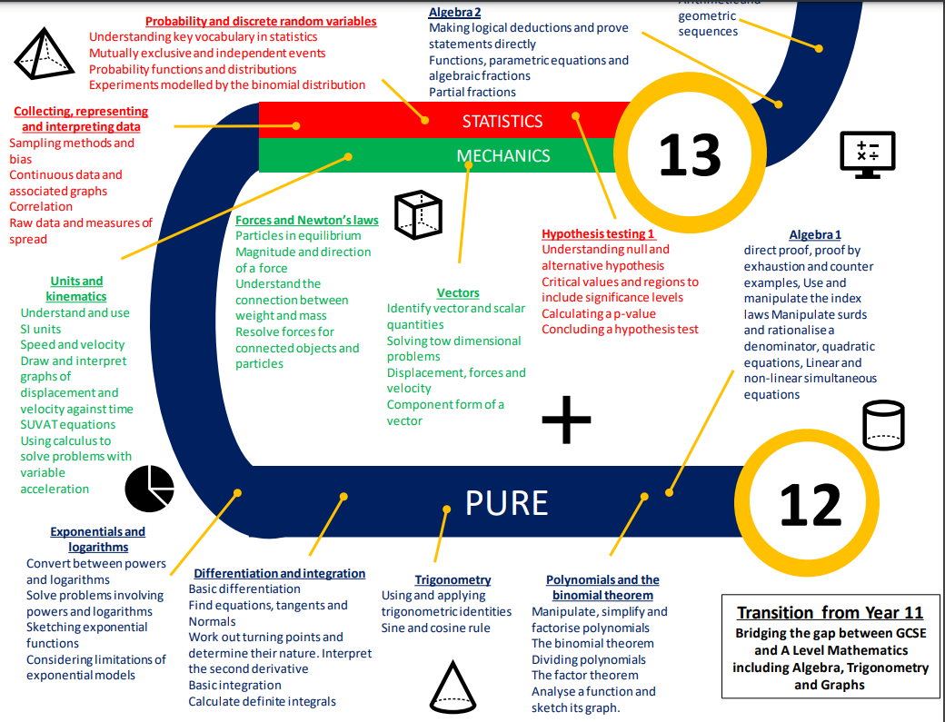
My Child’s Year 12 learning journey - Maths
Notes:
Higher/Foundation Tier
At the start of the GCSE course, we are aspirational and therefore expect most of our students to follow the higher tier curriculum. At the end of Year 10, we will have a better understanding of the path that will maximise the grade of the student. A definitive decision on tier of entry will only be made after the Year 11 mock examinations in January 2025.

Slide 4
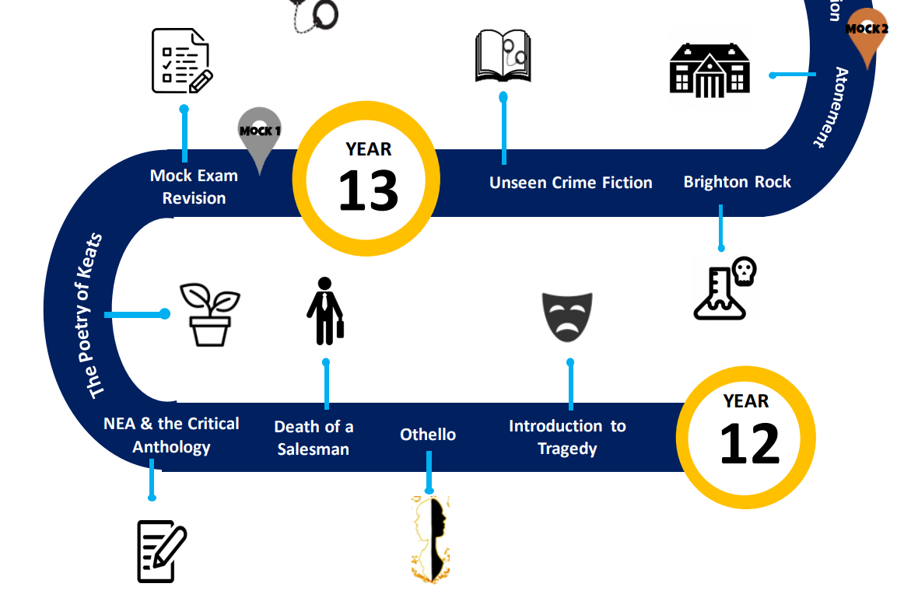
My Child’s Year 12 learning journey - English

Slide 5
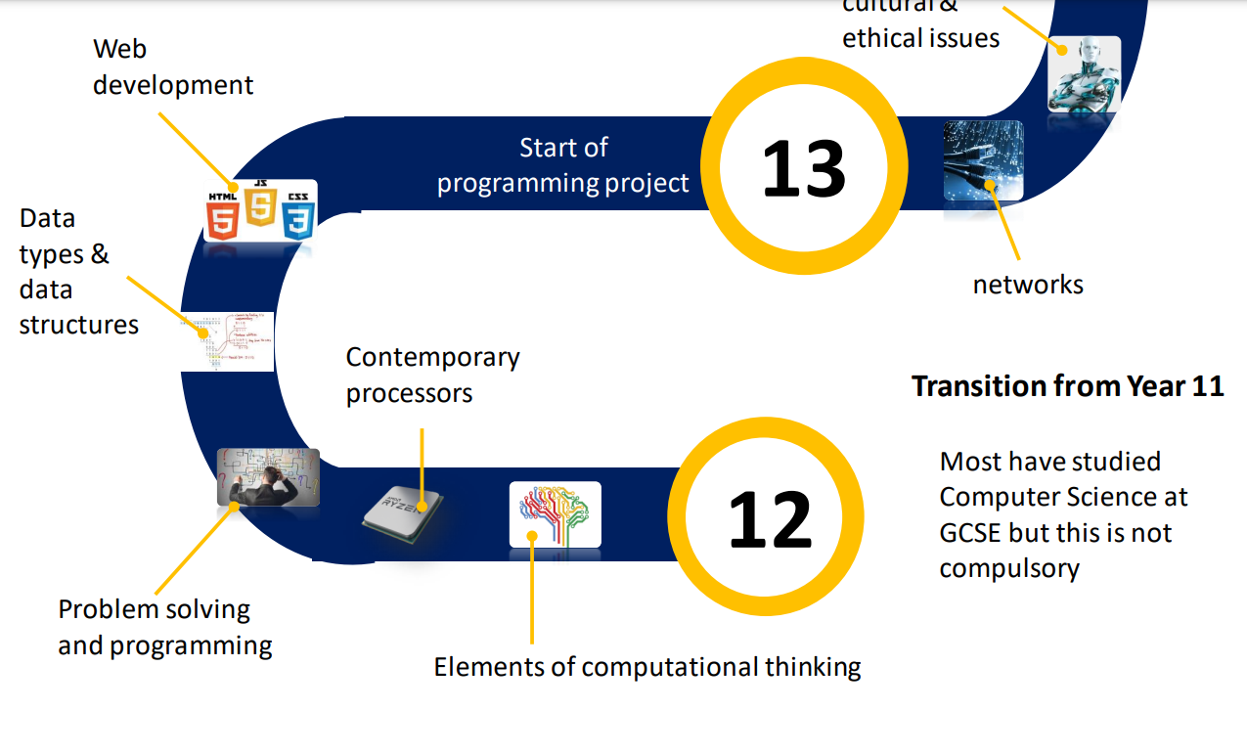
My Child’s Year 12 learning journey –Computer Science

Slide 6
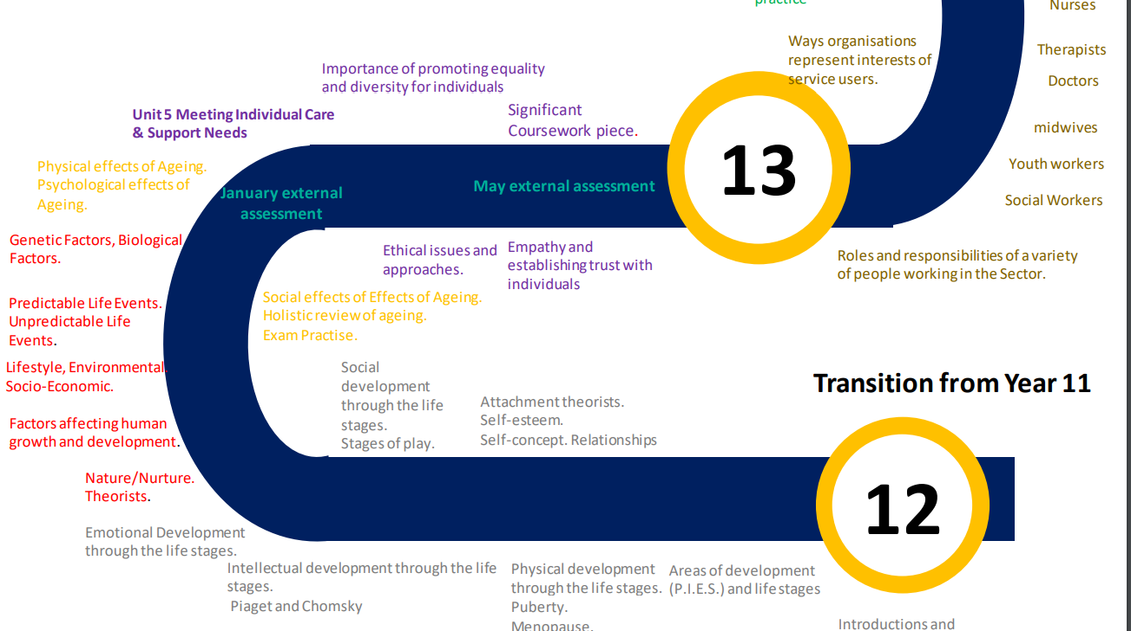
My Child’s Year 12 learning journey –Health and Social Care

Slide 7











How can I support my child in their learning journey?
Notes:
Do everything you can to support your child’s attendance in school. Please book medical appointments outside of school time and don’t take term time holidays.
Ensure that your child comes to school everyday with the appropriate equipment: pen, pencil, ruler, rubber, (glue stick and scissors are really helpful), calculator and PE kit when needed. All of this needs to be in a bag that is suitably large to carry equipment and books in.
Ensure that your child conforms to our dress code
Encourage your child to keep up to date with current affairs – watch the local, regional and national news with them..
Encourage your child to read daily – we have a well stocked library if they are short of a book to read.
Encourage your child to watch films and documentaries related to what they are learning in lessons.
Talk to your child about the topics they are learning – perhaps encourage them to teach you something new each day.
In Y7 students in the early stages will need with organising their homework including talking to them about what they need to do, helping them to plan their time, checking their work etc…
We release progress data three times per year. When this data is released to you it is advisable to talk about the data with your child. Highlight strengths and discuss areas for development.
If there are disappointments for students then encourage them to persist, reflect and think about what they might do differently next time. Taking ownership of their own progress is a hugely important factor in success at secondary school.

Slide 8
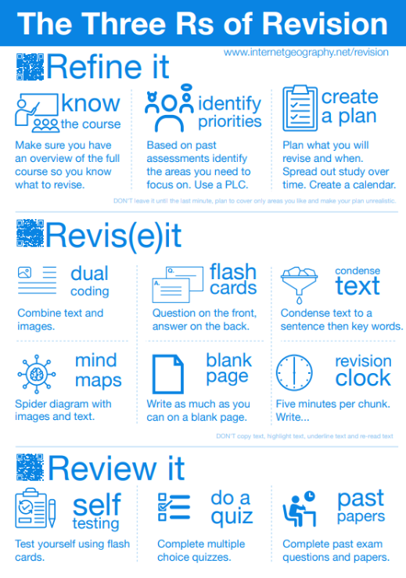
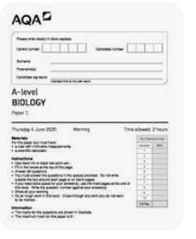
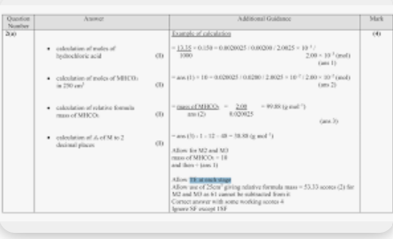
How can I support my
child in their revision?

Slide 9
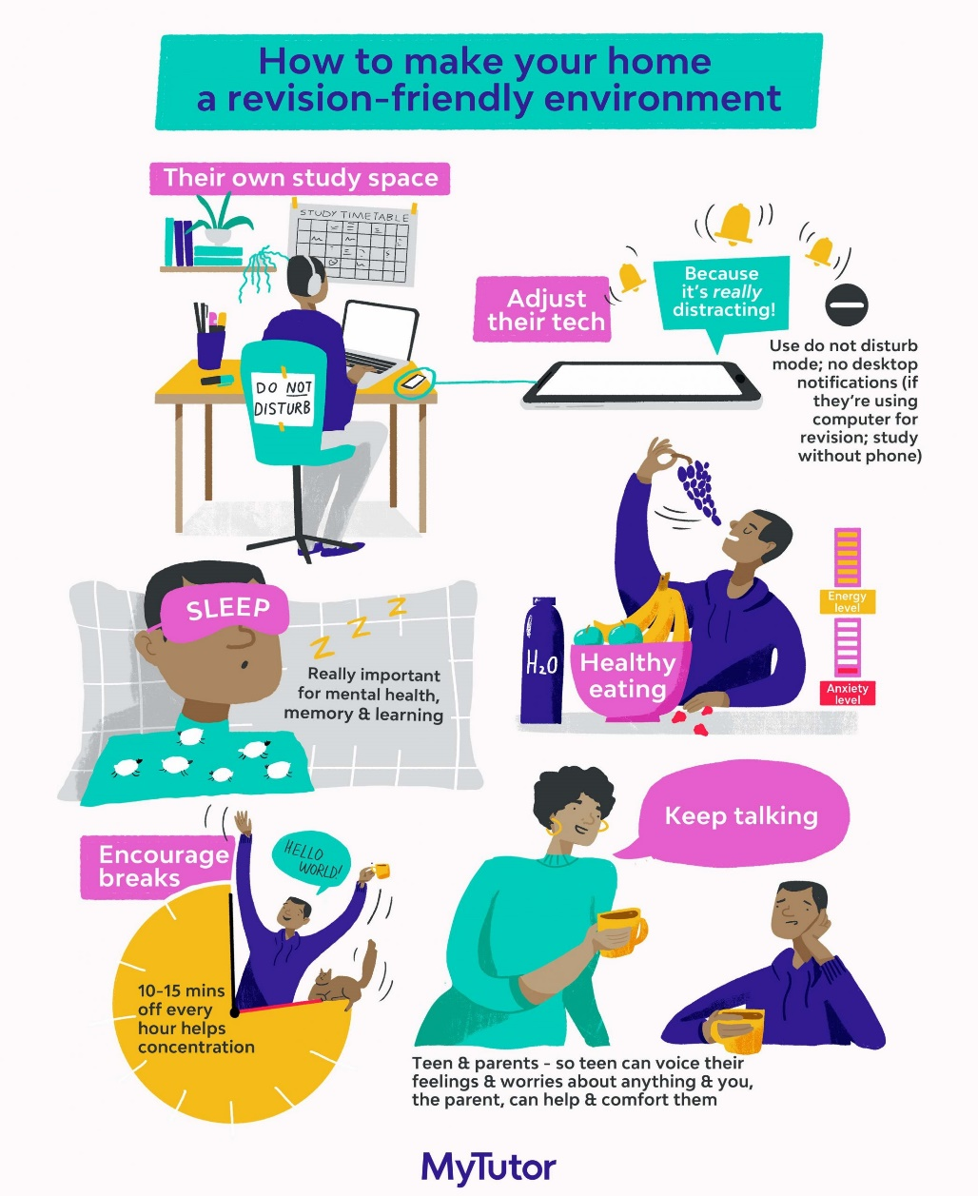
How can I support my child in their revision?
Flashcards: Question on one side – answers on the other. Ideal for then testing themselves or being tested by a friend / adult.
Start Big, go small: The first time they revise a topic fill an A3 sheet, then the net time reduce it to A4 and eventually to a flashcard. This encourages them to disregard the information they know between one revision sessions and the next.
Mind maps / diagrams: Good for more visual revision ie the human body, sections of the river…
Exam Question practice: Invaluable but cannot be used on its own as it doesn’t actually help students learn what they don’t know.
Markschemes: Become familiar with structures of answers/key terms.

Slide 10

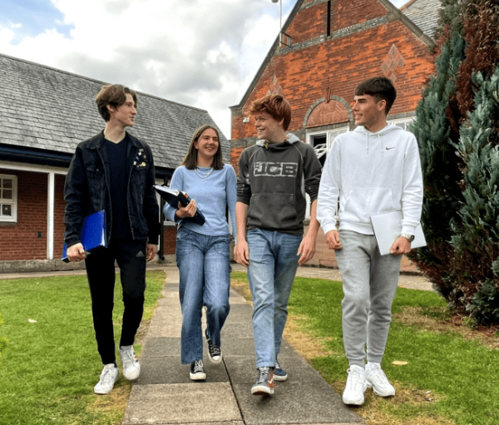
The AGS Way
Care
Aspire
Achieve

Slide 11

Expectations
Arrive to school fully equipped to learn
Arrive punctually – All students have maximum two minutes transition between lessons.
Line up outside a classroom and enter quietly
Silence for the register
Do not disrupt others in their learning
Phones/headphones/smartwatches – inappropriate use – confiscation
Exit in an orderly manner as directed by staff

Slide 12
The Study Period
Homework set by your teacher(s)
Complete the 1 hour after the lesson that you should do for each of your lessons;
go over the lesson content
Read the pages in the textbook directed to or other directed study (on Arbor)- other platforms such as TEAMS used by subject teachers and tutors, e-mail.
update notes
organise folder
Attend your enrichment ie. Lesson helping out or plan for your enrichment ie running a club
Check resource drawer – revision resources

Slide 13
Additional enrichment’
Moocs – Massive Open Online Courses
https://www.mooc.org/#course-categories
Record on enrichment log
Useful for – job applications, University applications (interviews), employment interviews, broaden knowledge
All directed study, homework, Key coursework deadlines – On Arbor

Slide 14



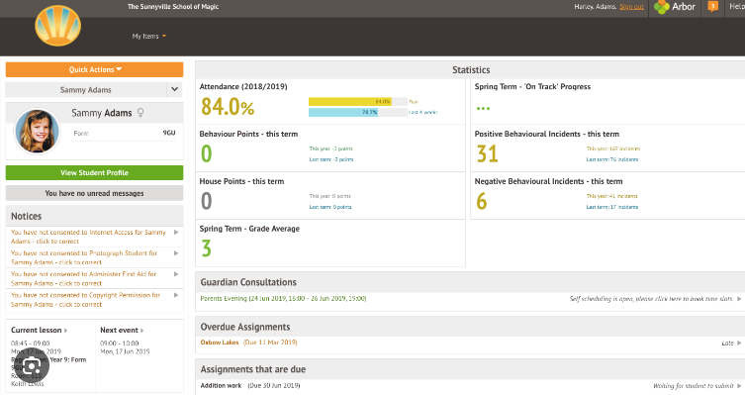
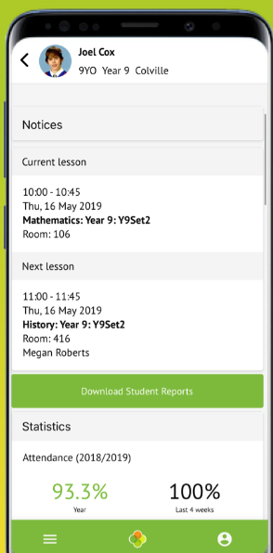
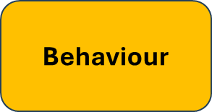
What is Arbor?
This is the Parent Portal delivering information between school and home
Attendance
Behaviour
Assessment
Communications
Timetables
Homework
Arbor App - available to download on your App store (ios/android)
Invites to sign into the portal will be sent out at the end of the first full week – check your registered email
Amend personal details
Directed Study
Notes:
Arbor is our Management Information System and contains all of your child’s details from contacts, timetables, medical details, assessment and homework.
Arbor’s parent portal is available via an internet web page but is also best accessed via the web app (check your emails for the login to the Arbor Antony Gell Portal)Your child will have their own login to the Arbor app (using their new school email)
The most important part of being able to access this system is to ensure the email you are currently using for your child (at junior school) is unique to you. No child nor adult can use the same email address, if parents share an email, both parents will not be able to independently access the system.
Attendance is real time – check your child is in school
Behaviour points (awarded by staff) show as positive and negative incidents
Homework is set through Arbor – you will be able to see the homework, but you cannot submit on behalf of your child
Assessment – termly grades will be available n this system along with report cards,
Communications- we will be developing greater in-app communication through notifications in 2025-26
You can amend basic details in this system
**N.B. For children who have parents living in separate homes, parents will only be able to view their own personal details, no details are shared with other contacts.

Slide 15


Taking internet safety seriously

Slide 16

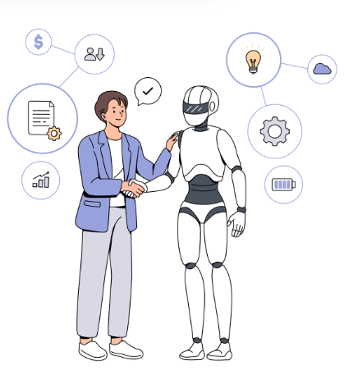
in school...
use of generative AI such as Canva
building critical thinking skills
effective prompts and referencing
AI in assessment
learn responsible use
at home...
24/7 learning support
AI is a highly useful tool in sixth form for tasks like research, personalized learning, administrative efficiency, and generating creative content, but students must use it ethically and critically, understanding its limitations and avoiding plagiarism by adding their own ideas and verifying information.
AI should complement, not replace, teacher input and critical engagement with the material.
How useful is AI for sixth from study?
use of smart tutor chatbots
tailored to individual needs
learning essential future digital skills
Notes:
IN SCHOOL
Canva an example of the generative AI we use at Gell - create images, presentations and other design work
also AI built in to Microsoft 365 - our main software package
AI covered as part of the Computer Science curriculum at KS4 - current use in society, data bias, privacy and copyright and the digital divide
Use of AI is allowed in some coursework - needs careful use and referencing but can be an invaluable tool.
Part of the revision lesson for y11s (still doing these? If so I can include use of AI)
Interactive Learning Platforms - AI powers interactive platforms that include games, quizzes, and simulations, making learning more engaging and fun for students.
AT HOME
With AI chatbots and virtual tutors, students can ask questions and get explanations anytime.
Students receive immediate feedback on their work through AI-powered tools, helping them learn from mistakes in real time and improve faster.
AI can analyse a student's learning habits, strengths, and weaknesses to deliver customized lessons. This means students learn at their own pace and in a way that suits their individual needs which leads to better engagement and retention.
Using AI tools helps students build essential digital skills like critical thinking, creativity, and tech literacy. This prepares them for careers in a rapidly changing world.

Slide 17
Oxford University Roadshow: 29th Sept 2025
Sixth Form Parents’ Evenings: 6 th November 2025 and 26th March 2026
Mock Exams: 22nd June to 3rd July 2026
Health and Social Care Exam: 9th January 2026
PE Exams: 12th January 2026
Start of External Exams: 7th May 2026
Work Experience Week: 9th – 13th Feb 2026
University and Apprenticeship Fair Trip (date to be confirmed)
Information regarding off-timetable days for personal development will be available in due course every half term;
Safety Day; GoDrive, About Alcohol (Change, Live, Grow) – 18th Nov
Interview Skills; East Midlands Chamber of Commerce – Summer term (tbc)
UCAS/Employment applications process begins in summer term of Year 12.

Slide 18
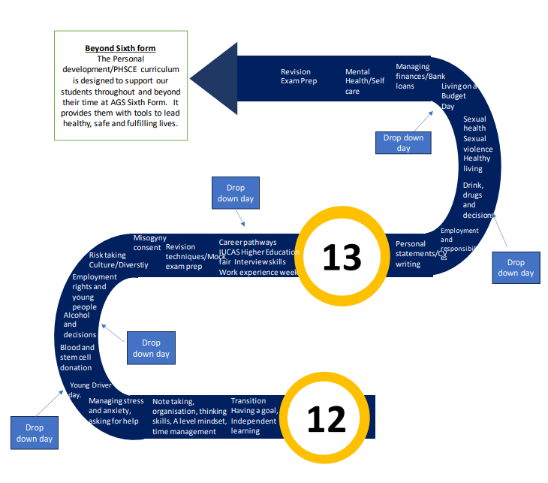

Slide 19
Enrichment Activities to get involved in.
Classroom Assistant; Examples; Technology, Science, English, BSL
Parents Evenings
Open Evenings – tours, subject Ambassadors
Run clubs – Can choose a club to help with or set up
School newsletter assistants
Reading Buddies
Tea, Tech and Talk
Music assistants
Event organisation
Sports help
Sports Leaders – Qualification
Student Parliament
Duke of Edinburgh Award Assistant
Community – Wirksworth Colts, Tea, Tech and Talk
Leadership Roles – Charity, House, Well-Being, Eco, Diversity.
Enrichment Logs
Record enrichment
Record skills gained

Slide 20

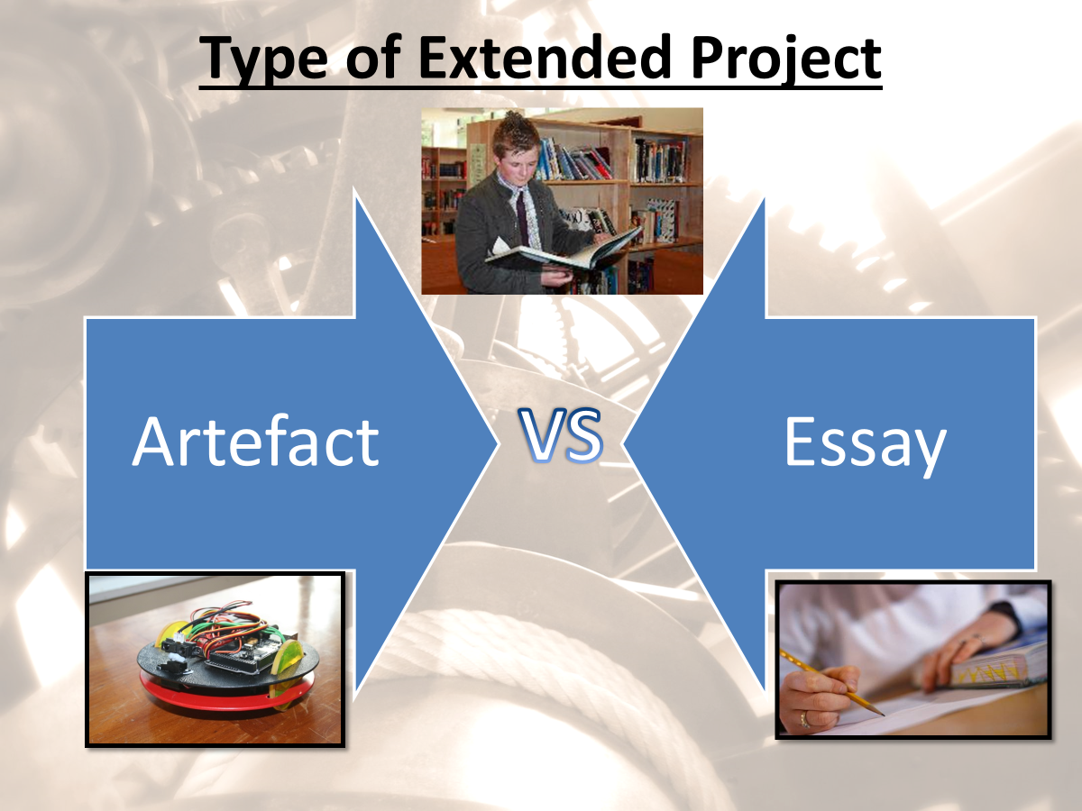
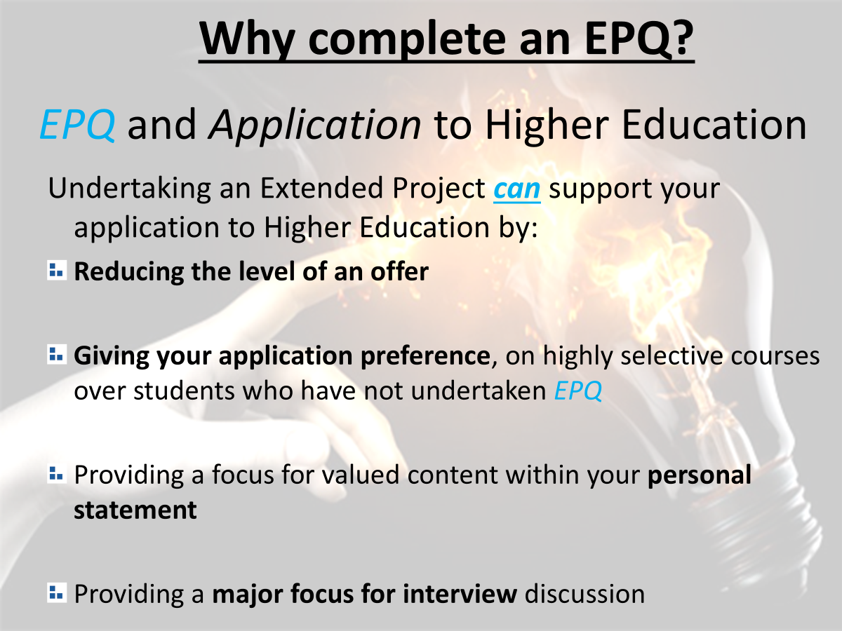
EPQ (October)

Slide 21
