Slide 1
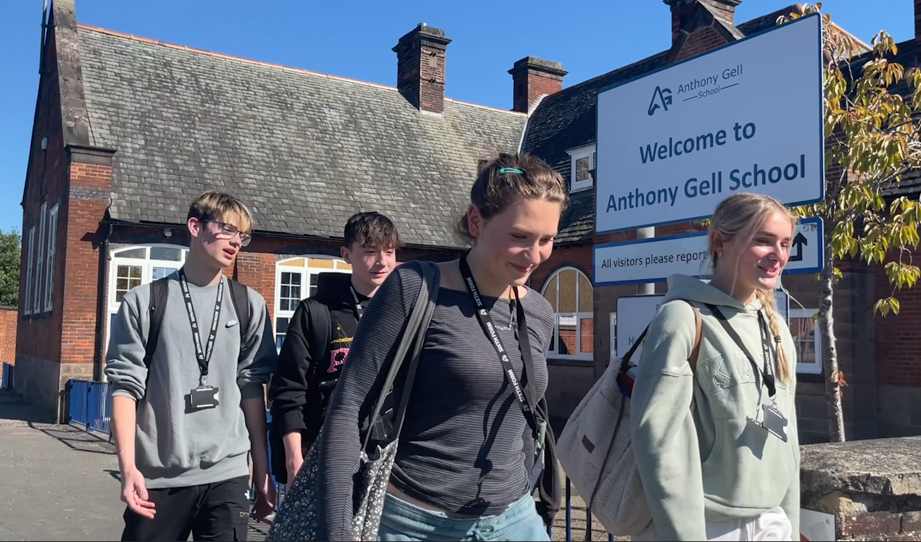

AGS Year 12 Curriculum Information Evening

Slide 2

Oxford University Roadshow is 1st October 2024
Careers Fair is 14th November 2024
Sixth Form Parents’ Evenings are 7th November 2024 and 27th March 2025
Mock Exams are 24th June to 4th July 2025
Start of External Exams is 6th May 2025
Work Experience is 10th to 14th February 2025
Young Drivers Day is 14th November
University and Apprenticeship Fair Trip is 24th April 2025
Change, Grow, Live Day is 26th November
Interview Skills Day – March: exact date tbc with East Midlands Chamber of Commerce
Additional Dates
Progress data sent home on 5th December 2024, 26th March 2025 and 18th July 2025
https://www.anthonygell.co.uk/parents/term-dates/
AGS Year 12 Key Calendar Dates

Slide 3
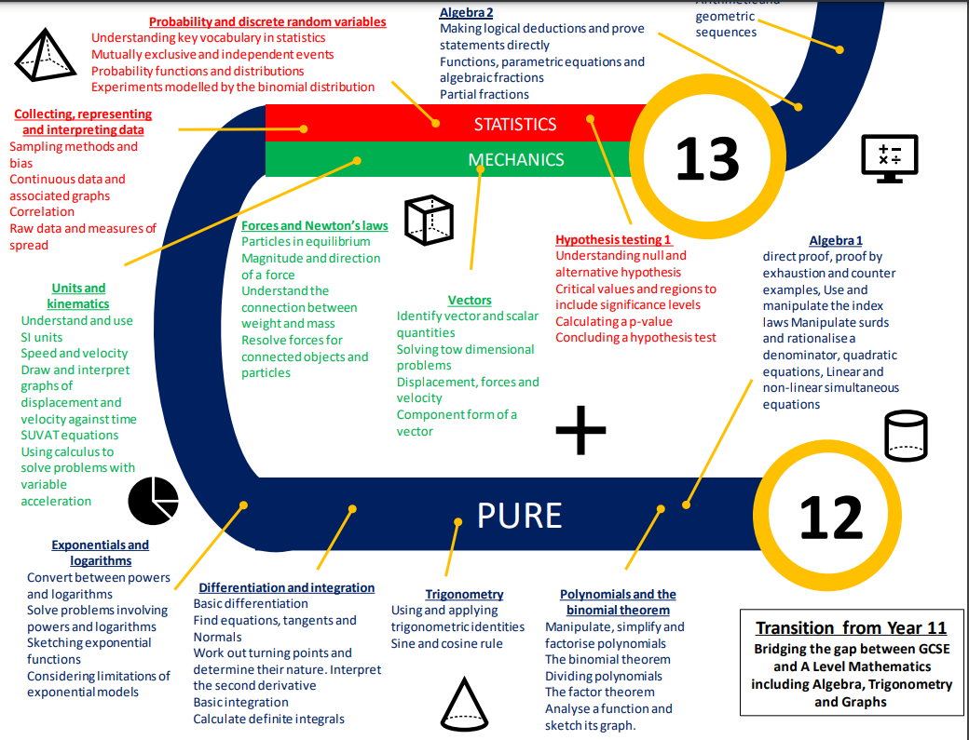
My Child’s Year 12 learning journey - Maths
Notes:
Higher/Foundation Tier
At the start of the GCSE course, we are aspirational and therefore expect most of our students to follow the higher tier curriculum. At the end of Year 10, we will have a better understanding of the path that will maximise the grade of the student. A definitive decision on tier of entry will only be made after the Year 11 mock examinations in January 2025.

Slide 4
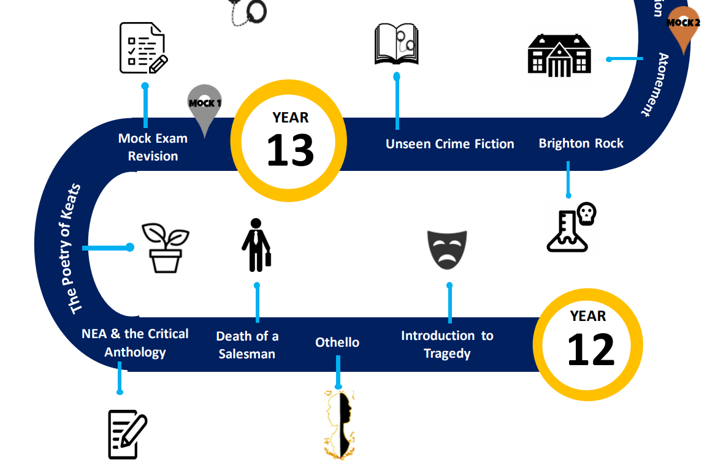
My Child’s Year 12 learning journey - English

Slide 5
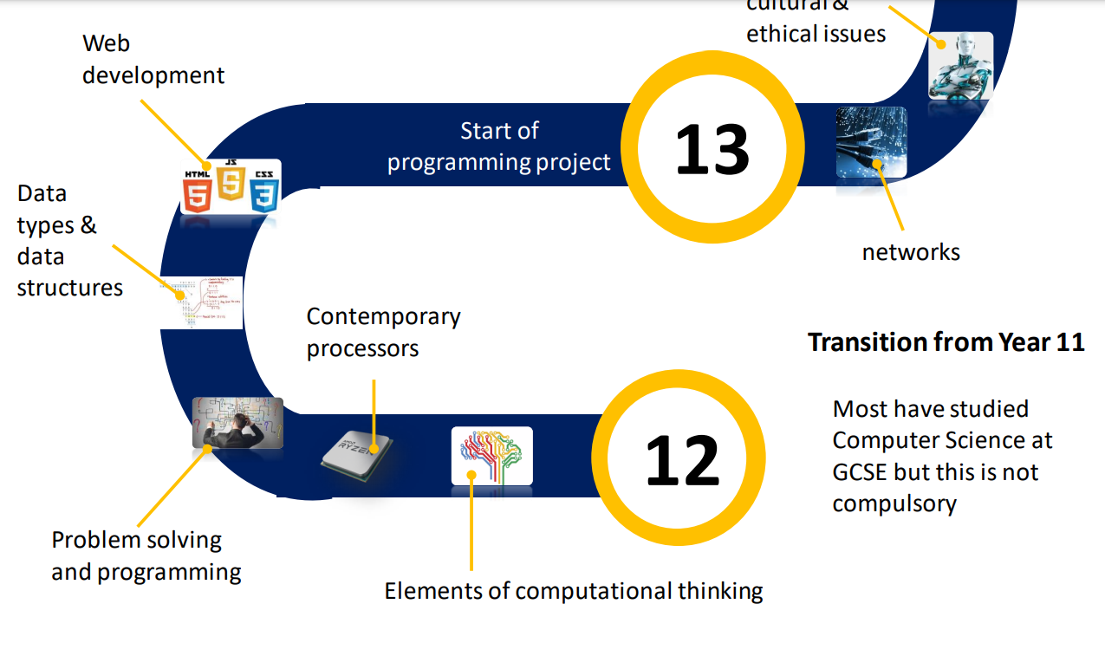
My Child’s Year 12 learning journey –Computer Science

Slide 6
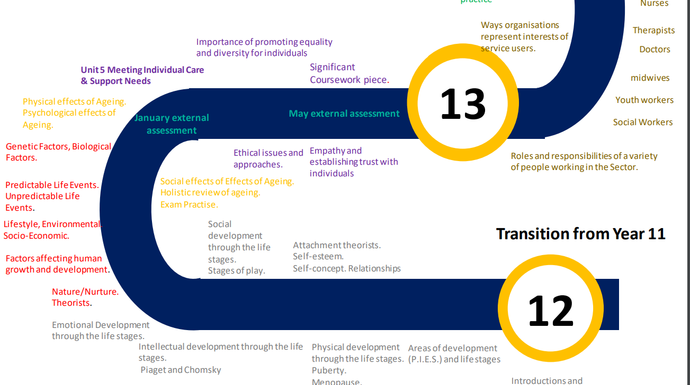
My Child’s Year 12 learning journey –Health and Social Care

Slide 7









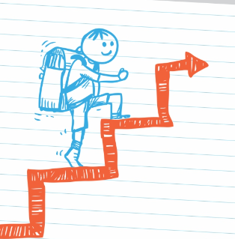

How can I support my child in their learning journey?
Notes:
Do everything you can to support your child’s attendance in school. Please book medical appointments outside of school time and don’t take term time holidays.
Ensure that your child comes to school everyday with the appropriate equipment: pen, pencil, ruler, rubber, (glue stick and scissors are really helpful), calculator and PE kit when needed. All of this needs to be in a bag that is suitably large to carry equipment and books in.
Ensure that your child conforms to our dress code
Encourage your child to keep up to date with current affairs – watch the local, regional and national news with them..
Encourage your child to read daily – we have a well stocked library if they are short of a book to read.
Encourage your child to watch films and documentaries related to what they are learning in lessons.
Talk to your child about the topics they are learning – perhaps encourage them to teach you something new each day.
In Y7 students in the early stages will need with organising their homework including talking to them about what they need to do, helping them to plan their time, checking their work etc…
We release progress data three times per year. When this data is released to you it is advisable to talk about the data with your child. Highlight strengths and discuss areas for development.
If there are disappointments for students then encourage them to persist, reflect and think about what they might do differently next time. Taking ownership of their own progress is a hugely important factor in success at secondary school.

Slide 8
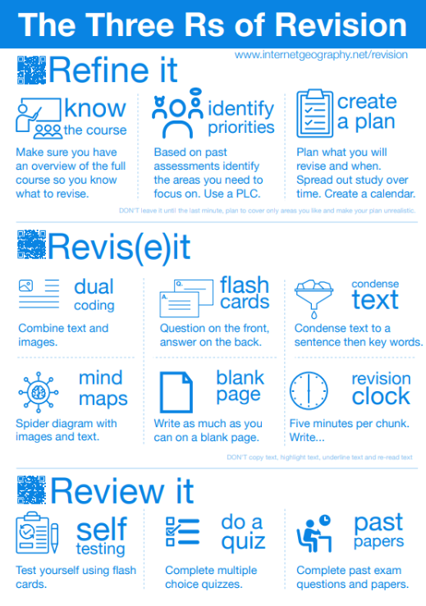
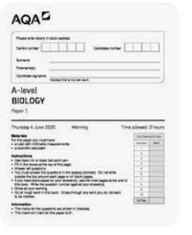
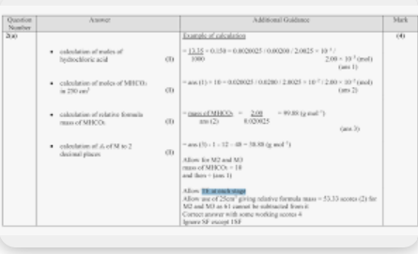
How can I support my
child in their revision?

Slide 9
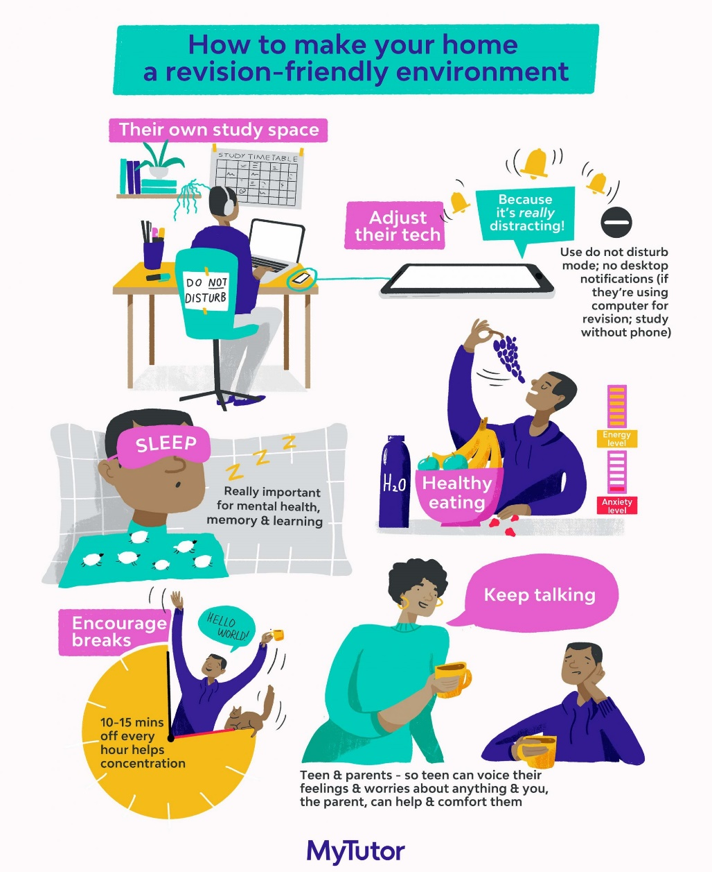
How can I support my child in their revision?
Flashcards: Question on one side – answers on the other. Ideal for then testing themselves or being tested by a friend / adult.
Start Big, go small: The first time they revise a topic fill an A3 sheet, then the net time reduce it to A4 and eventually to a flashcard. This encourages them to disregard the information they know between one revision sessions and the next.
Mind maps / diagrams: Good for more visual revision ie the human body, sections of the river…
Exam Question practice: Invaluable but cannot be used on its own as it doesn’t actually help students learn what they don’t know.
Markschemes: Become familiar with structures of answers/key terms.

Slide 10

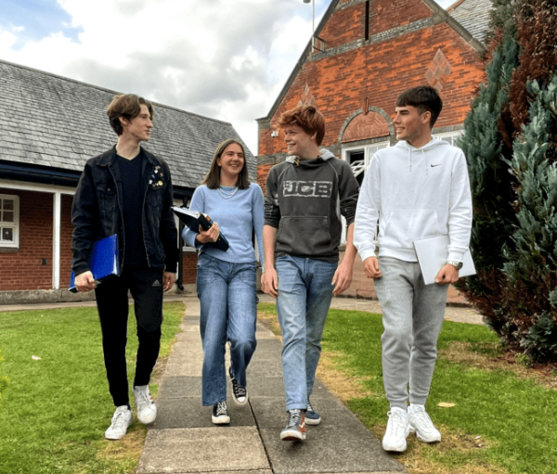
The AGS Way
Care
Aspire
Achieve

Slide 11
Arrive to school fully equipped to learn
Arrive punctually – All students have maximum two minutes transition between lessons.
Wait outside the classroom until invited in and enter quietly – remember you are our role models!
Silence for the register
Phones/headphones/smartwatches - inappropiate use will lead to confiscation
Exit in an orderly manner as directed by staff
Expectations

Slide 12
Homework set by your teacher(s)
Complete the 1 hour of study support as soon after the lesson as possible
Go over the lesson content
Read the pages in the textbook directed to or complete other directed study (on Arbor)
Update notes
Organise folder
Attend your enrichment ie. Lesson helping out, planning for your enrichment ie running a club
Check resource drawer – revision resources
How to make the best use of Study Periods

Slide 13
Additional enrichment
Moocs – Massive Open Online Courses
https://www.mooc.org/#course-categories
Record on enrichment log
Useful for – job applications, University applications (interviews), employment interviews, broaden knowledge
All directed study, homework, Key coursework deadlines – On Arbor
How will we support your child’s next steps?

Slide 14


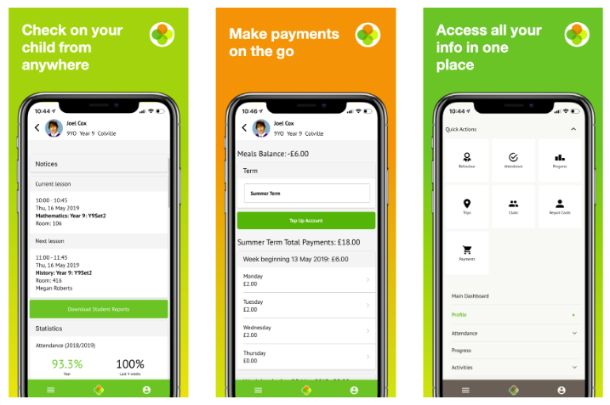


Parental Engagement - Arbor
Arbor is our new parent/student portal
Student access is now open
Parent access is now rolled out via the app
View and amend your personal details e.g. next of
kin/contact details, parental permissions e.g. photos
Phased rollout of student information. Initially:
  Timetable
  Student details
  Attendance
  Behaviour
  Homework
Future functions will be introduced
  Student progress/data/exams/payments
App is available on your app store – iOS, Android
Arbor will be available on your chosen device e.g. phone/tablet/desktop

Slide 15
Oxford University Roadshow is 1st October 2024
Careers Fair is 14th November 2024
Sixth Form Parents’ Evenings are 7th November 2024 and 27th March 2025
Mock Exams are 24th June to 4th July 2025
Start of External Exams is 6th May 2025
Work Experience is 10th to 14th February 2025 (launch 21st Oct – database)
Young Drivers Day is 14th November
University and Apprenticeship Fair Trip is 24th April 2025
Change, Grow, Live Day is 26th November
Interview Skills Day – March: exact date tbc with East Midlands Chamber of Commerce
How will we support your child’s next steps?
UCAS application process begins on summer term of year 12 – personal statement

Slide 16
Enrichment Activities to get involved in.
Classroom Assistant; Examples; Technology, Science, English, BSL
Parents Evenings
Open Evenings – tours, subject Ambassadors
Run clubs – Can choose a club to help with or set up
School newsletter assistants
Reading Buddies
Tea, Tech and Talk
Music assistants
Event organisation
Sports help
Sports Leaders – Qualification
Sixth form Student Council
Student Parliament
Duke of Edinburgh Award Assistant
Enrichment Logs
Record enrichment
Record skills gained

Slide 17
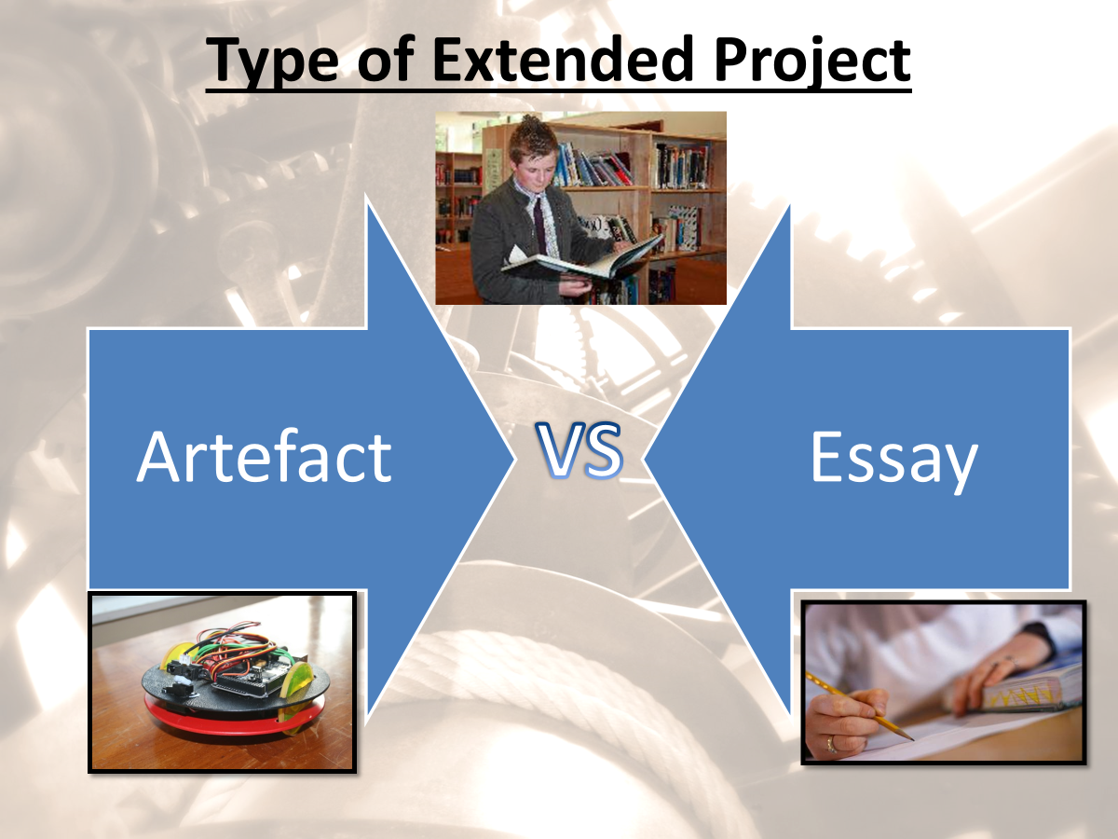

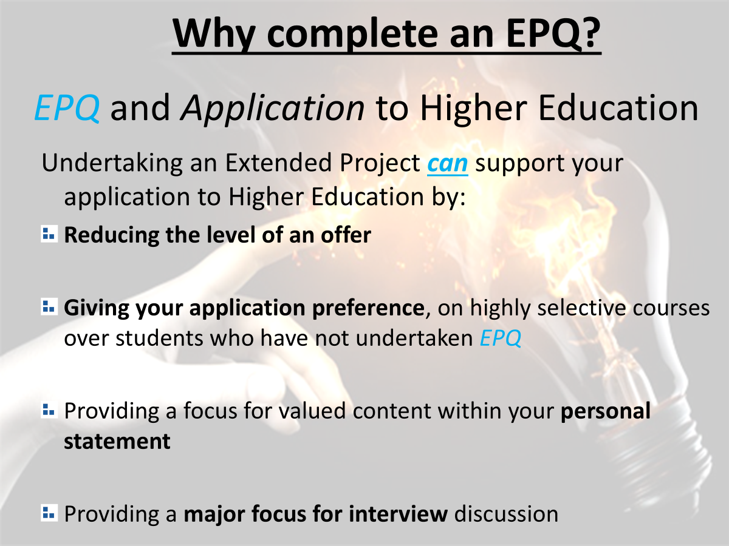
EPQ

