Slide 1
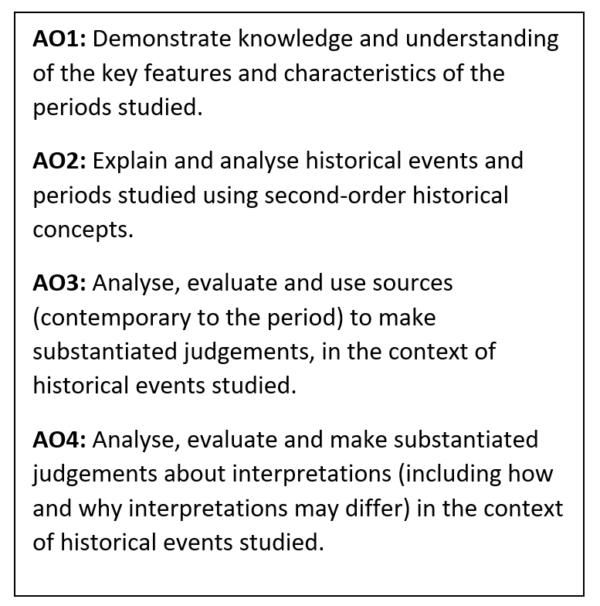
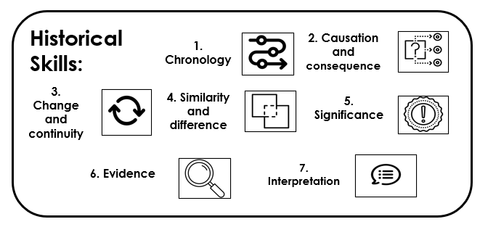
History Learning Journey
Beyond AGS
Revision
Depth Study: 2S
Breadth Study: 1H
NEA
12
Breadth Study: 1H
Depth Study: 2S
NEA
13
Revision
Origins of the Cold War
Cold War crises
The end of the Cold War
Life in Nazi Germany
Nazi control and dictatorship
Hitler’s rise to power
Paper 2: British depth study study
Paper 2: Period study
Paper 3: Modern depth study
11
Paper 3: Modern depth study
Queen, government and religion
Challenges to Elizabeth at home and abroad
Elizabethan society in the Age of Exploration
Renaissance medicine
Industrial medicine
Modern medicine
Western Front medicine
Medieval medicine
10
Paper 1:Thematic study and historic environment
The Post War World
Assessment:
Essay
Assessment:
Sources
The Weimar Republic
The Holocaust
The Second World War
The interwar period and Nazi Germany
The First World War
9
Assessment:
Interpretations
Assessment:
Essay
Civil Rights in the USA
Local history unit
Early Stuart Britain
8
Later Stuart Britain
The Atlantic Slave Trade
The British Empire
Industrial Britain
Revolution, protest and democracy
Elizabethan England
Assessment:
Interpretations
Assessment:
Sources
Early Tudor England
7
Primary School
Life in medieval England
Power and religion in medieval England
The Norman Conquest
What is history?
Ancient civilisations
Pre-1066 Britain
Key skills
Assessment:
Interpretations
Assessment:
Sources
Assessment:
Essay
History introductory key words test

